Slide 1
計算物理
Schrödinger equation

Slide 2
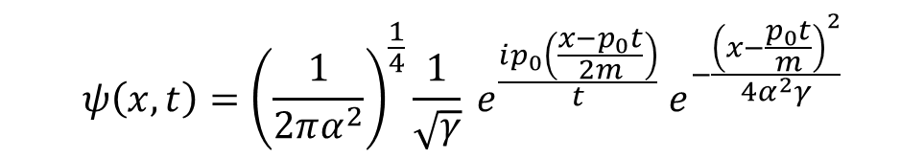

Problem
Use the Crank-Nicholson method to solve the problem of a free wave packet
$$\tilde{ψ}\left(p\right)={\left(\frac{1}{2πβ^{2}}\right)}^{\frac{1}{4}}e^{−\frac{{\left(p−p_{0}\right)}^{2}}{4β^{2}}}$$
$$ψ\left(x,t\right)={\left(\frac{1}{2πα^{2}}\right)}^{\frac{1}{4}}\frac{1}{\sqrt{γ}} e^{\frac{ip_{0}\left(\frac{x−p_{0}t}{2m}\right)}{t}} e^{−\frac{{\left(x−\frac{p_{0}t}{m}\right)}^{2}}{4α^{2}γ}}$$

Slide 3
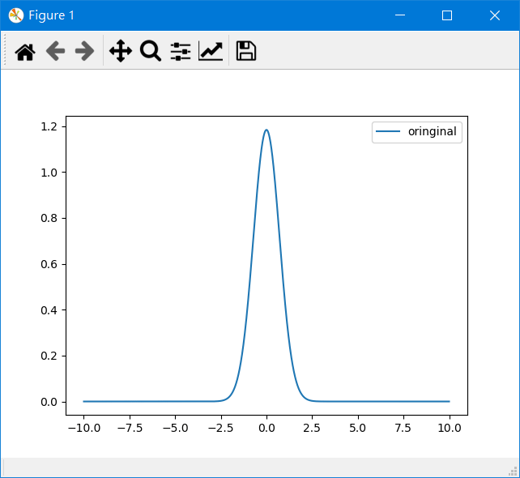
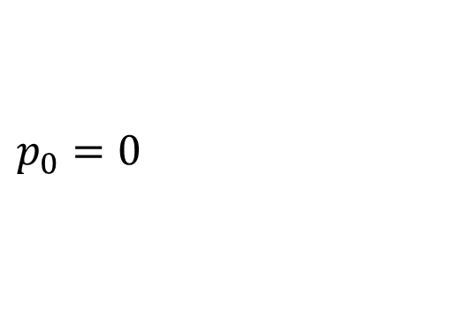
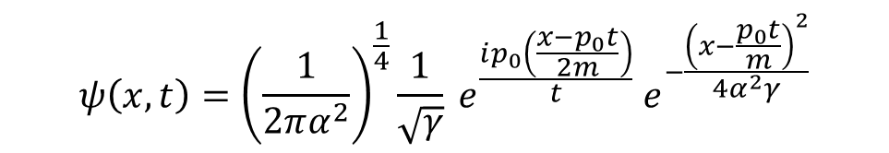
$$p_{0}=0$$
$$ψ\left(x,t\right)={\left(\frac{1}{2πα^{2}}\right)}^{\frac{1}{4}}\frac{1}{\sqrt{γ}} e^{\frac{ip_{0}\left(\frac{x−p_{0}t}{2m}\right)}{t}} e^{−\frac{{\left(x−\frac{p_{0}t}{m}\right)}^{2}}{4α^{2}γ}}$$

Slide 4
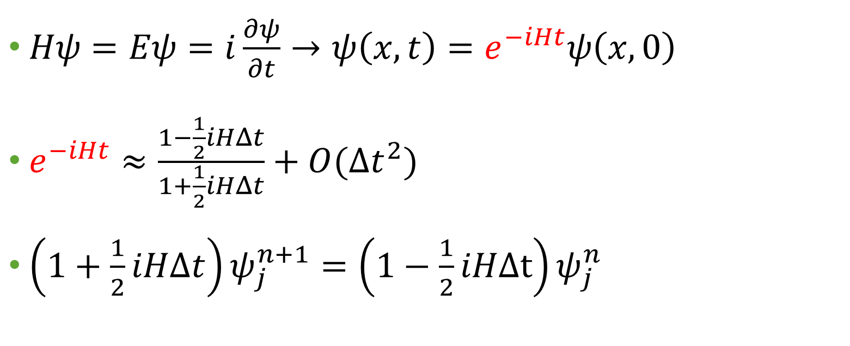
Crank-Nicholson method?
$Hψ=Eψ=i\frac{∂ψ}{∂t}→ψ\left(x,t\right)=e^{−iHt}ψ\left(x,0\right)$
$e^{−iHt}≈\frac{1−\frac{1}{2}iHΔt}{1+\frac{1}{2}iHΔt}+O(Δt^{2})$
$\left(1+\frac{1}{2}iHΔt\right)ψ_{j}^{n+1}=\left(1−\frac{1}{2}iHΔt\right)ψ_{j}^{n}$

Slide 5
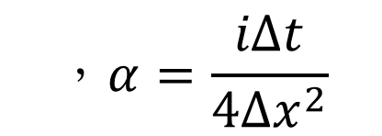
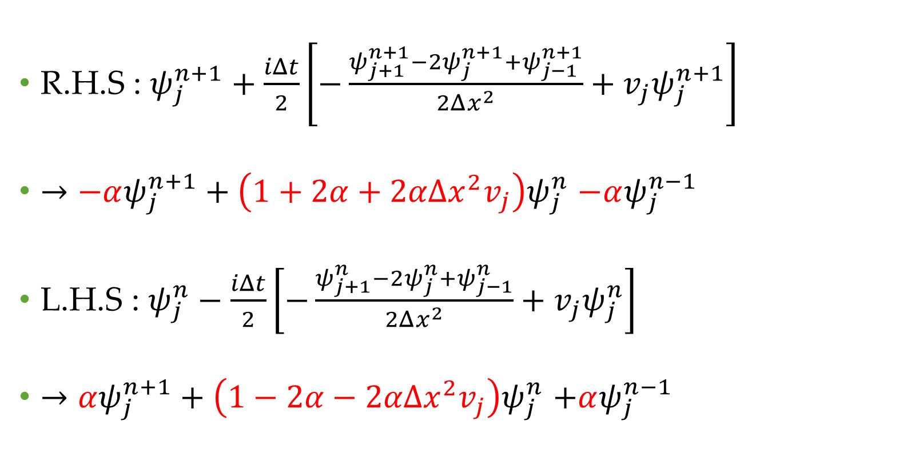
R.H.S : $ψ_{j}^{n+1}+\frac{iΔt}{2}\left[−\frac{ψ_{j+1}^{n+1}−2ψ_{j}^{n+1}+ψ_{j−1}^{n+1}}{2Δx^{2}}+v_{j}ψ_{j}^{n+1}\right]$
$→−αψ_{j}^{n+1}+\left(1+2α+2αΔx^{2}v_{j}\right)ψ_{j}^{n}$ $−αψ_{j}^{n−1}$
L.H.S : $ψ_{j}^{n}−\frac{iΔt}{2}\left[−\frac{ψ_{j+1}^{n}−2ψ_{j}^{n}+ψ_{j−1}^{n}}{2Δx^{2}}+v_{j}ψ_{j}^{n}\right]$
$→αψ_{j}^{n+1}+\left(1−2α−2αΔx^{2}v_{j}\right)ψ_{j}^{n}$ $+αψ_{j}^{n−1}$
$$，α=\frac{iΔt}{4Δx^{2}}$$

Slide 6
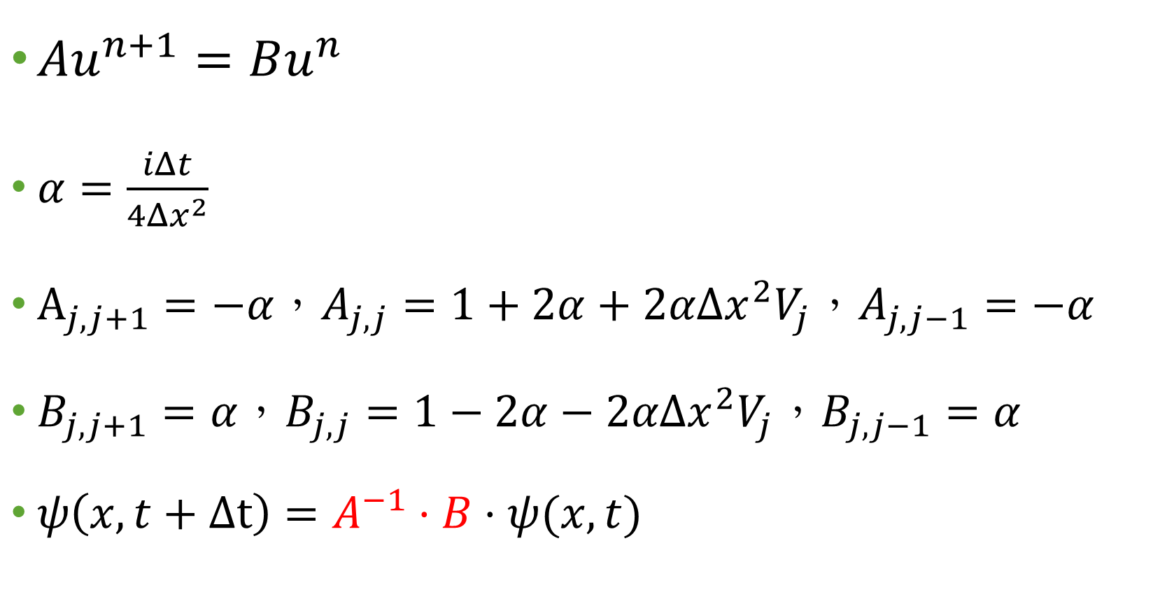
$Au^{n+1}=Bu^{n}$
$α=\frac{iΔt}{4Δx^{2}}$
$A_{j,j+1}=−α，A_{j,j}=1+2α+2αΔx^{2}V_{j}，A_{j,j−1}=−α$
$B_{j,j+1}=α，B_{j,j}=1−2α−2αΔx^{2}V_{j}，B_{j,j−1}=α$
$ψ\left(x,t+Δt\right)=A^{−1}⋅B⋅ψ(x,t)$

Slide 7
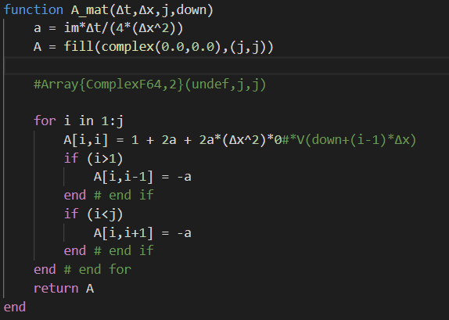
A matrix

Slide 8
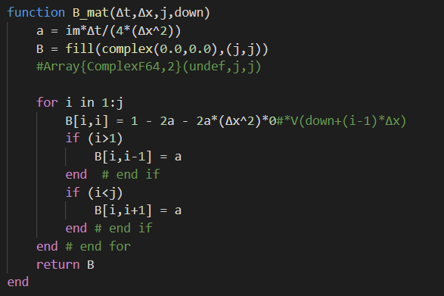
B matrix

Slide 9
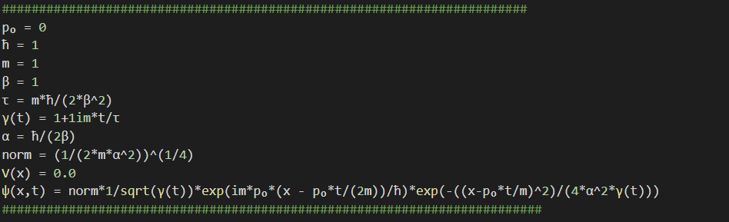
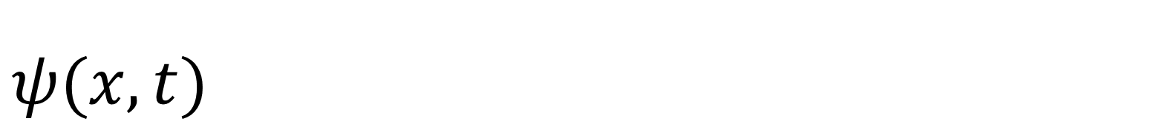
$$ψ(x,t)$$

Slide 10
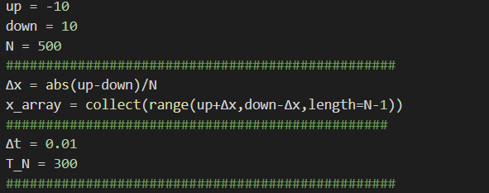
Control condition

Slide 11
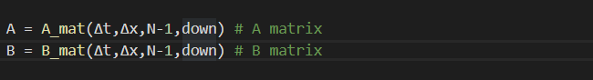
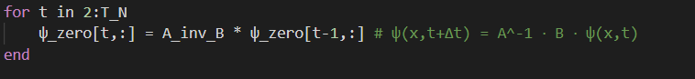

$$ψ\left(x,t+Δt\right)=A^{−1}⋅B⋅ψ(x,t)$$

Slide 12
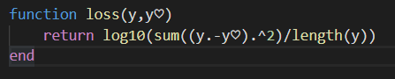
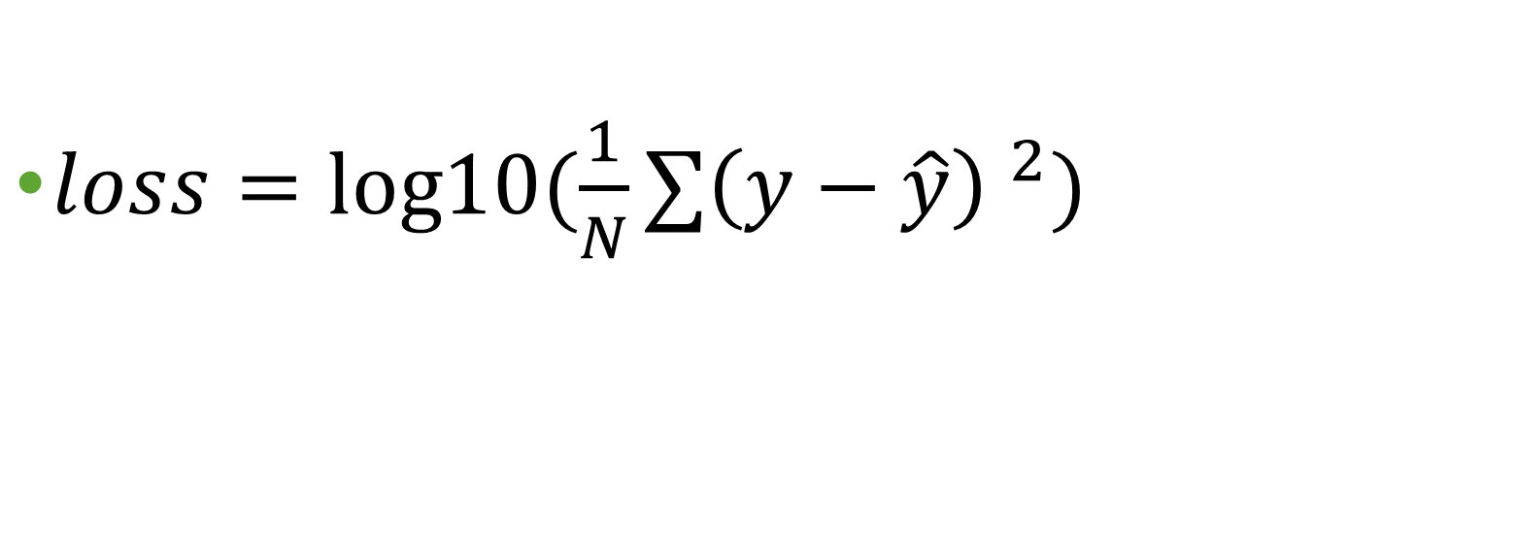
Error function
$loss=log10⁡(\frac{1}{N}∑{\left(y−\hat{y}\right) }^{2})$

Slide 13
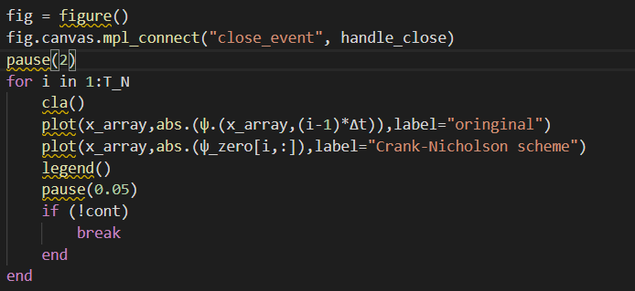
Plot animation

Slide 14
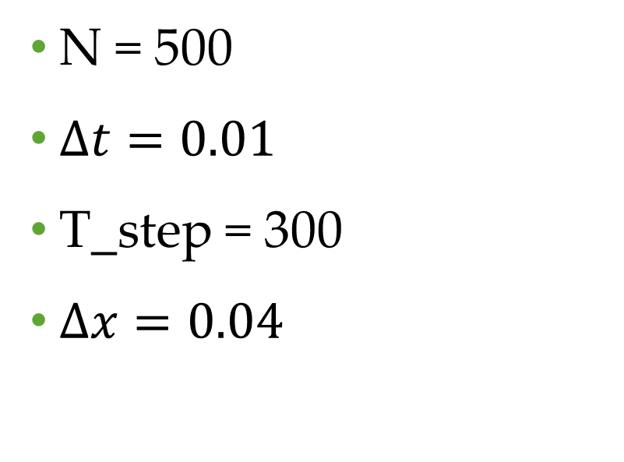
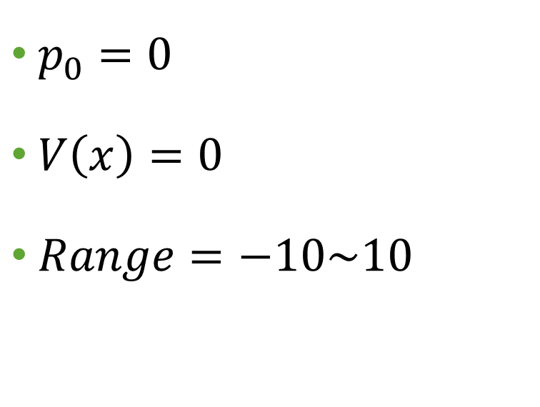
condition
$p_{0}=0$
$V\left(x\right)=0$
$Range=−10\sim 10$
N = 500
$Δt=0.01$
T_step = 300
$Δx=0.04$

Slide 15
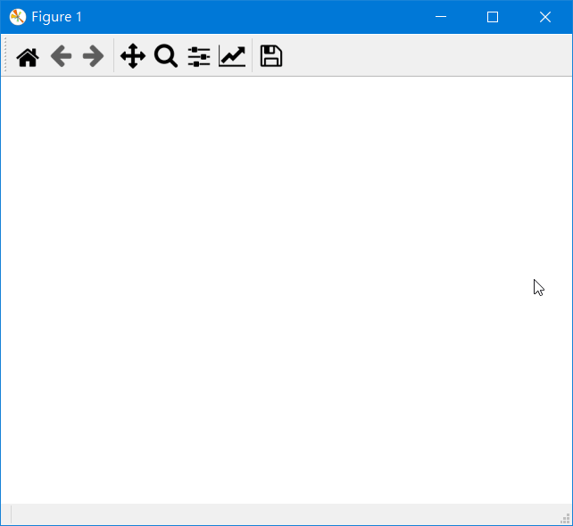

Slide 16
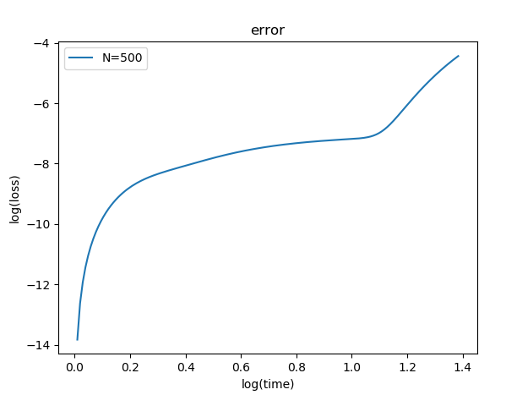
error

Slide 17
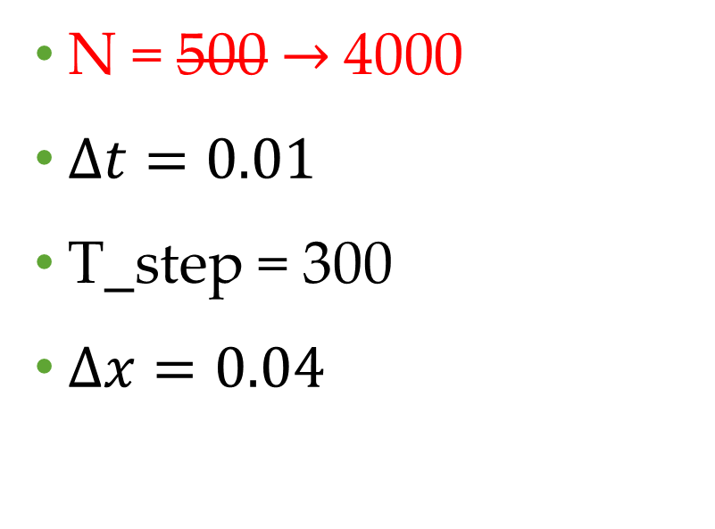
condition
$p_{0}=0$
$V\left(x\right)=0$
$Range=−10\sim 10$
N = 500$→$4000
$Δt=0.01$
T_step = 300
$Δx=0.04$

Slide 18
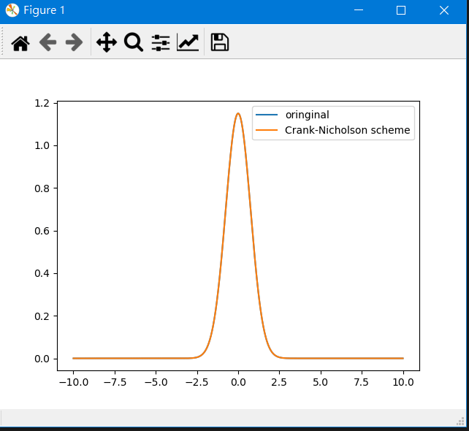

Slide 19
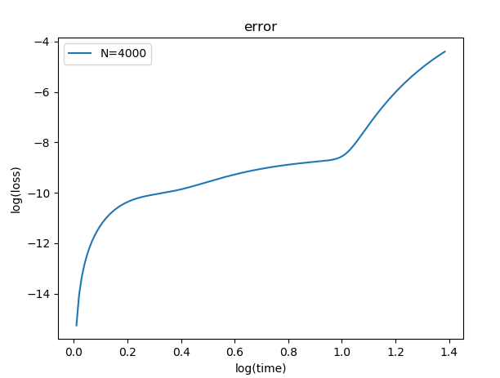
error

Slide 20

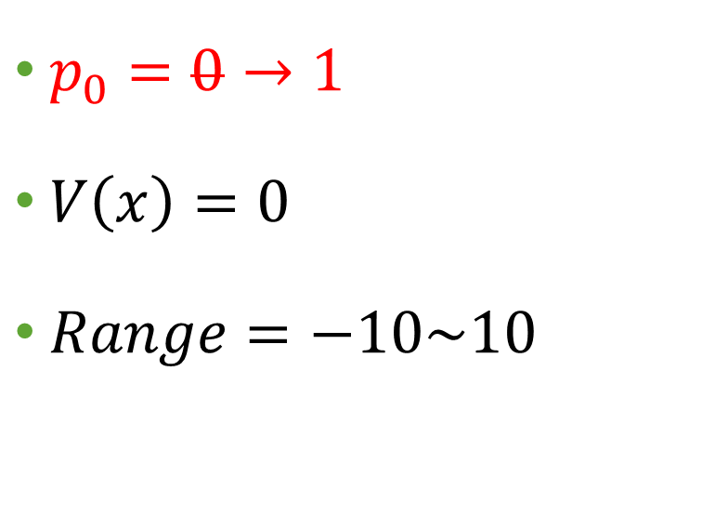
condition
$p_{0}=0→1$
$V\left(x\right)=0$
$Range=−10\sim 10$
N = 4000
$Δt=0.01$
T_step = 300
$Δx=0.04$

Slide 21
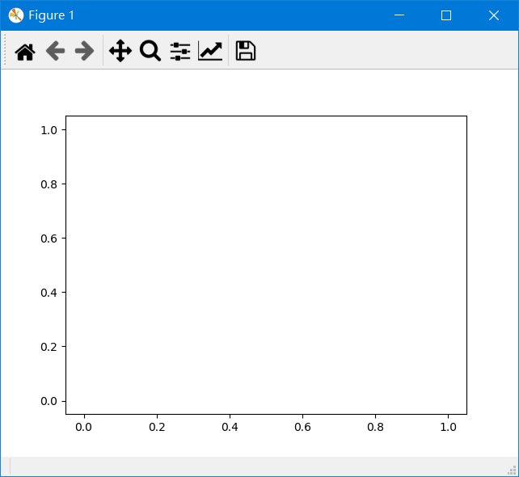

Slide 22
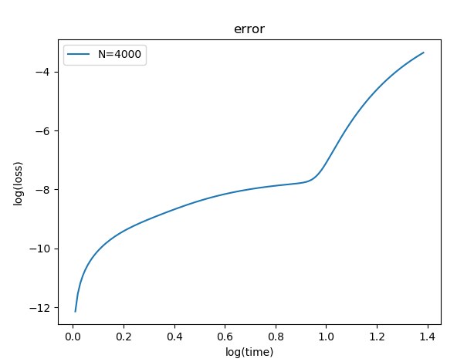

Slide 23
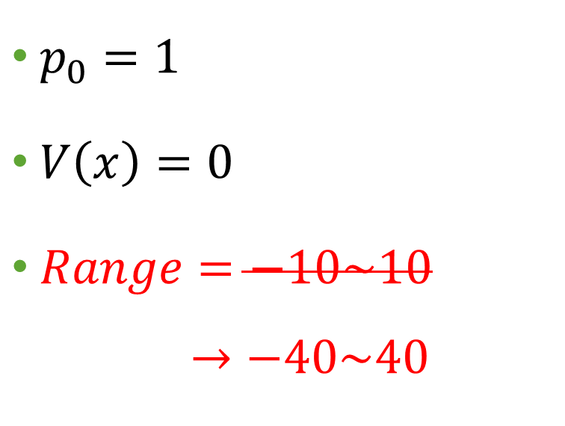
condition
$p_{0}=1$
$V\left(x\right)=0$
$Range=−10\sim 10$
$$→−40\sim 40$$
N = 4000
$Δt=0.01$
T_step = 300
$Δx=0.04$

Slide 24
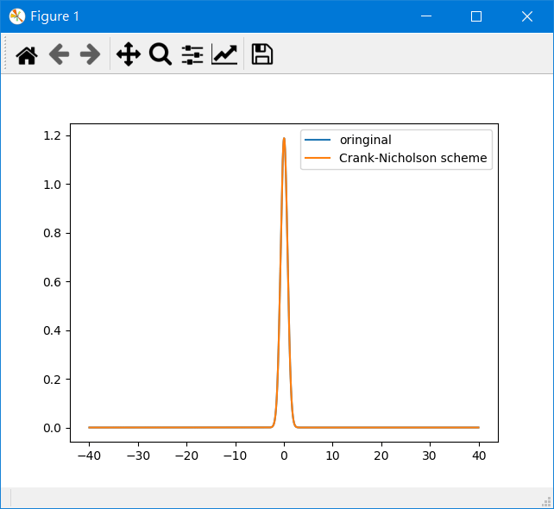

Slide 25
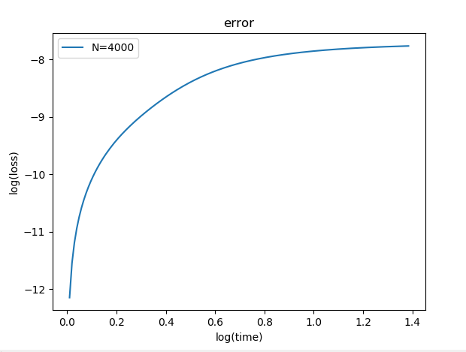

Slide 26
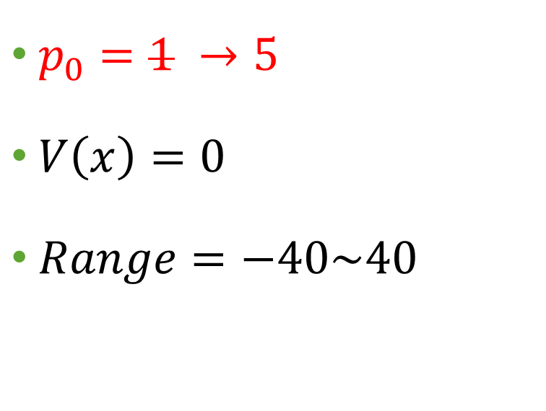
condition
$p_{0}=1 →5$
$V\left(x\right)=0$
$Range=−40\sim 40$
N = 4000
$Δt=0.01$
T_step = 300
$Δx=0.04$

Slide 27
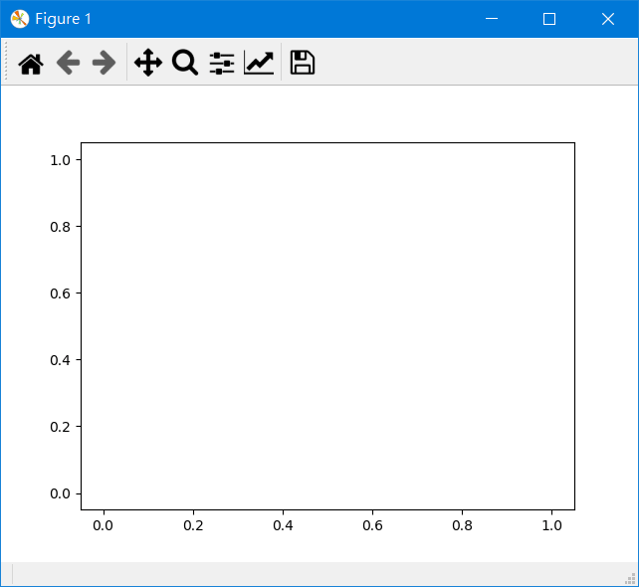

Slide 28
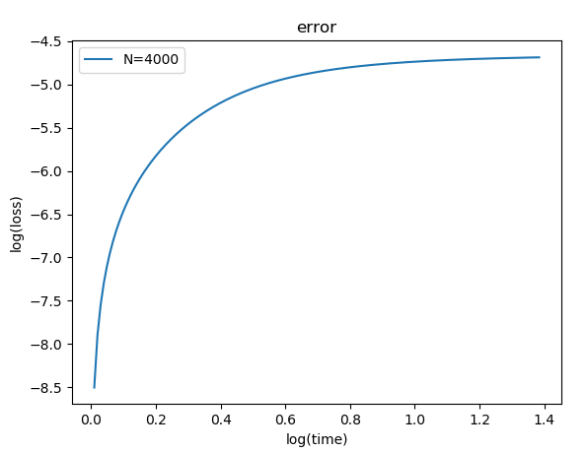

Slide 29
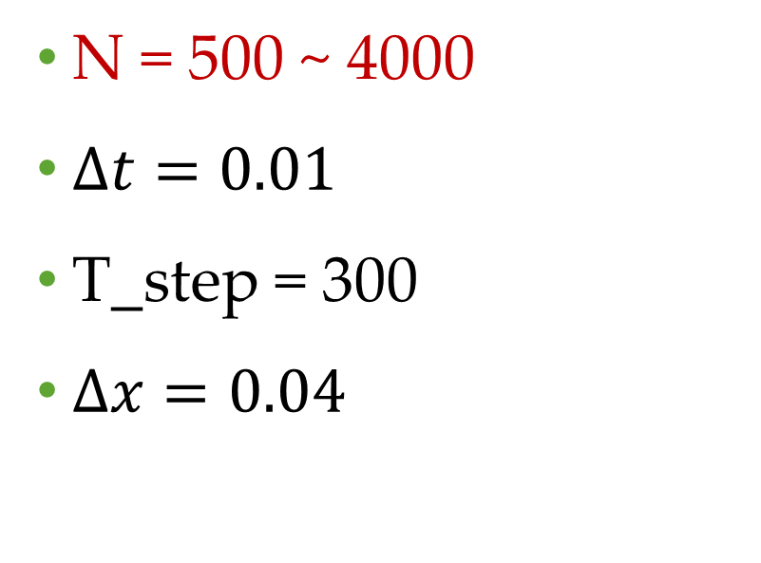
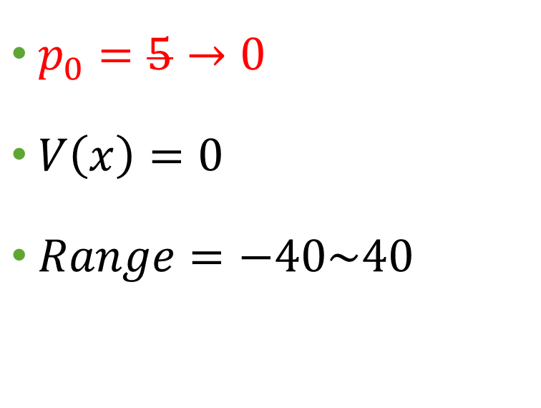
condition
$p_{0}=5→0$
$V\left(x\right)=0$
$Range=−40\sim 40$
N = 500 ~ 4000
$Δt=0.01$
T_step = 300
$Δx=0.04$

Slide 30
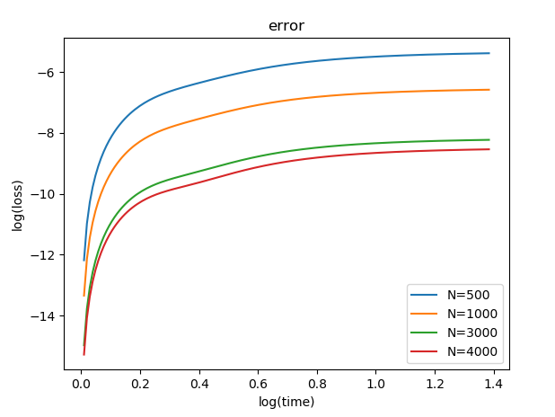

Slide 31
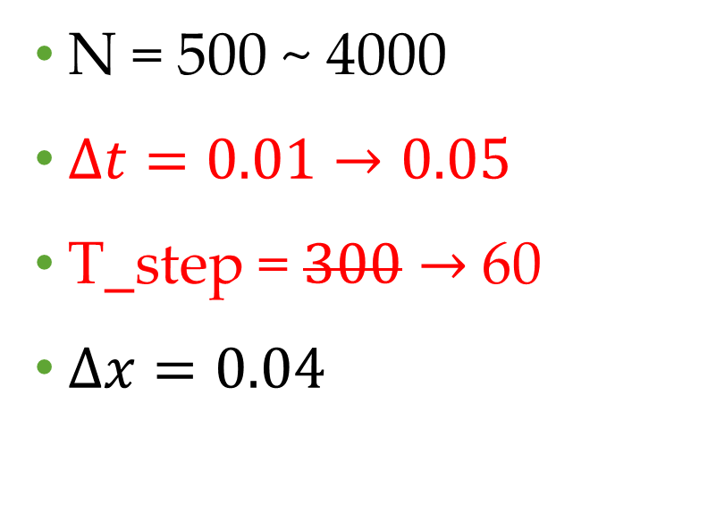

condition
$p_{0}=0$
$V\left(x\right)=0$
$Range=−40\sim 40$
N = 500 ~ 4000
$Δt=0.01→0.05$
T_step = $300→$60
$Δx=0.04$

Slide 32
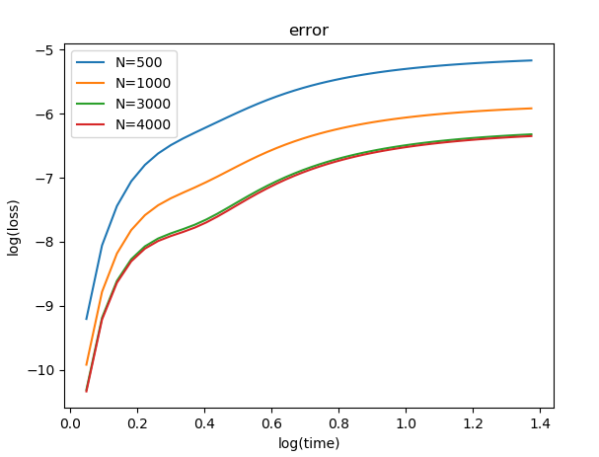

Slide 33
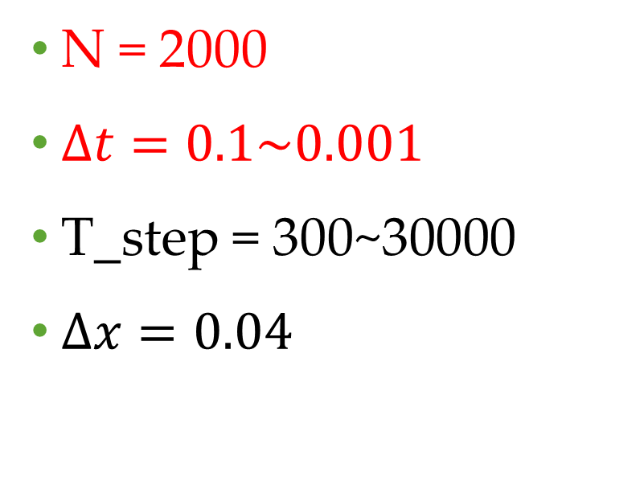
condition
$p_{0}=0$
$V\left(x\right)=0$
$Range=−40\sim 40$
N = 2000
$Δt=0.1\sim 0.001$
T_step = 300~30000
$Δx=0.04$

Slide 34
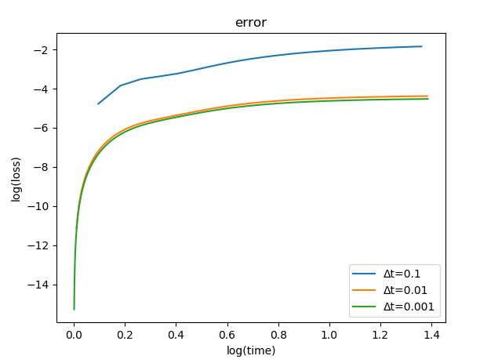

Slide 35

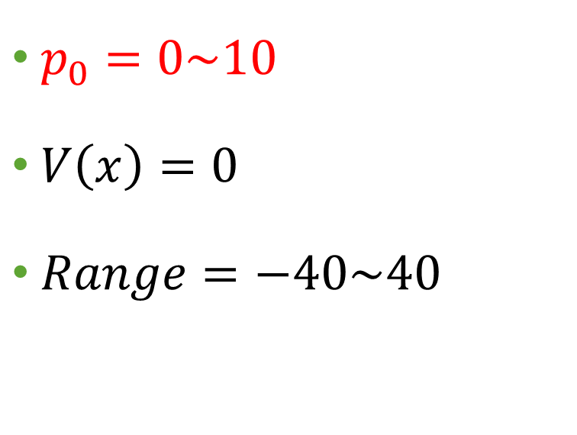
condition
$p_{0}=0\sim 10$
$V\left(x\right)=0$
$Range=−40\sim 40$
N = 2000
$Δt=0.01$
T_step = 300
$Δx=0.04$

Slide 36
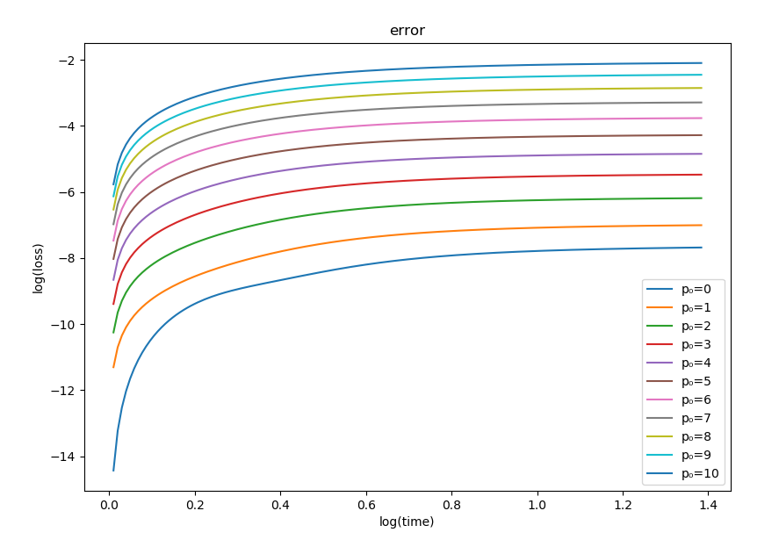

Slide 37
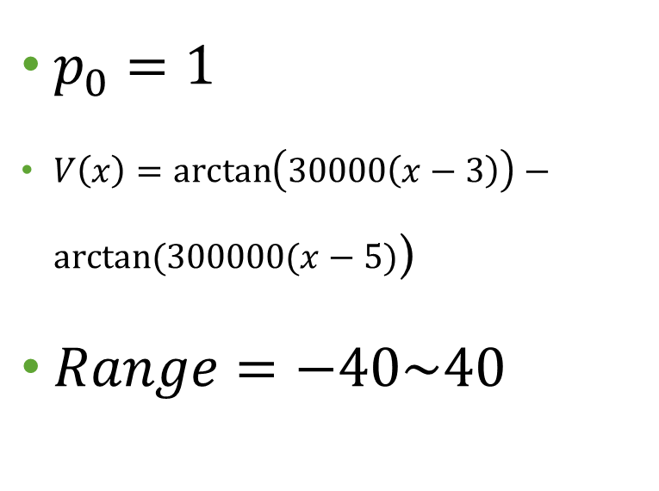
condition
$p_{0}=1$
$V\left(x\right)=\arctan\left(30000\left(x−3\right)\right)−arctan⁡(300000(x−5)$)
$Range=−40\sim 40$
N = 2000
$Δt=0.01$
T_step = 300
$Δx=0.04$

Slide 38
